Slide 1
COURSE SUBSTITUTION & RECIPROCITY-
LOCAL DEGREEES AND CERTIFICATES, GENERAL EDCUATION AND ADTS
Presented by:
Estela Narrie- Articulation Officer, Monica College
Aimee Tran- Articulation Officer, Saddleback College

Slide 2


Slide 3
Overview
Reciprocity & General Education Patterns
Course Substitution & Certificates & Degrees
Associate Degree for Transfer- ADTs

Slide 4
Reciprocity
Merriam- Webster Dictionary: REC-I-PROC-I-TY
(res-uh-pros-i-tee): noun. a situation or relationship in which two people or groups agree to do something similar for each other.
Colleges that adopt a reciprocity policy honor the ways in which courses are used at other community colleges when certifying that course work at their college.

Slide 5
GE Reciprocity- applied local general education pattern
Course to Course comparability
Regional reciprocity
Honoring courses in other CCC GE patterns
AP (CCC GE AP)/CLEP/IB
C-ID

Slide 6
GE Reciprocity- Applied (cont.)
IGETC & CSU GE transfer patterns
Course to course comparability (not for CCC, but for private or out of state)
CCC reciprocity established by UC & CSU
AP/CLEP/IB for CSU GE
AP/IB for IGETC

Slide 7
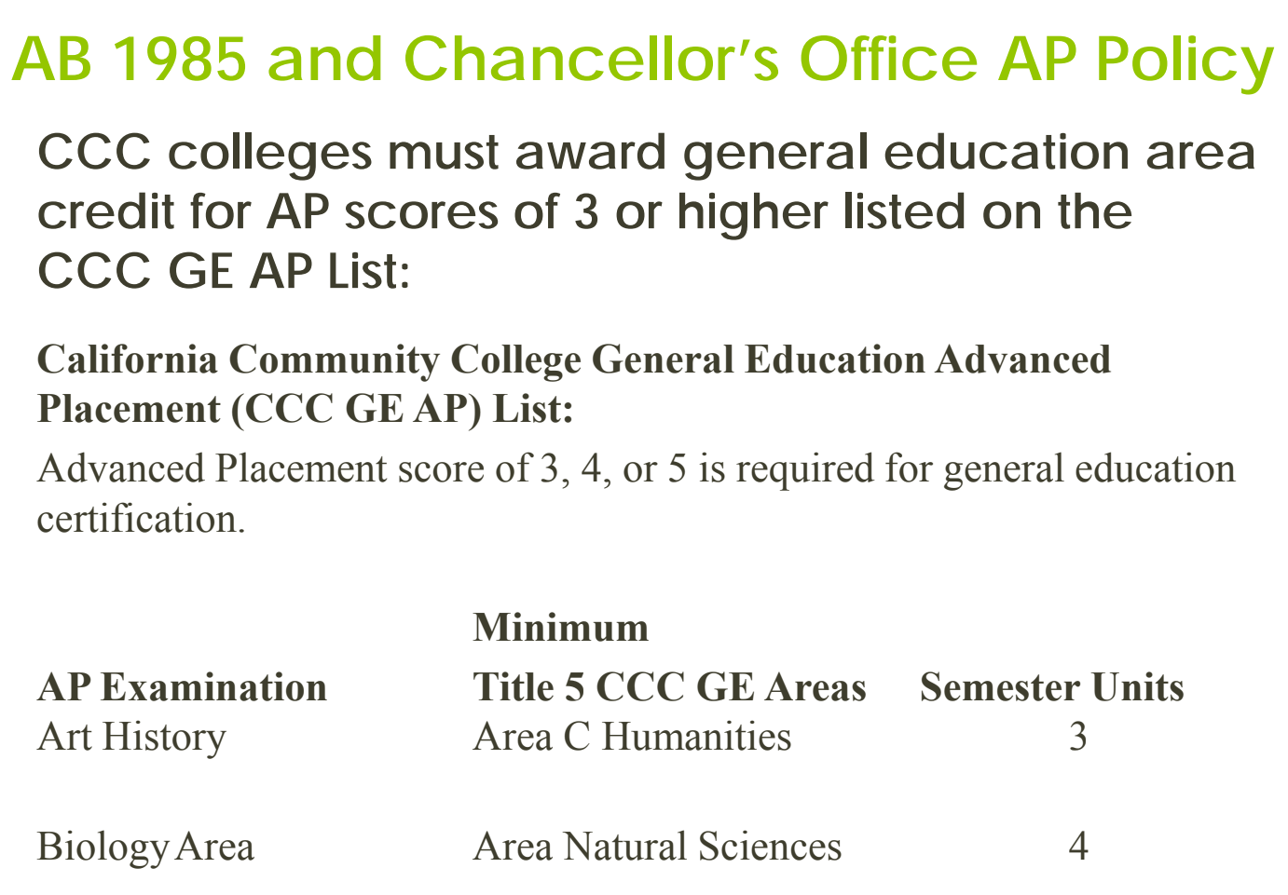

Slide 8
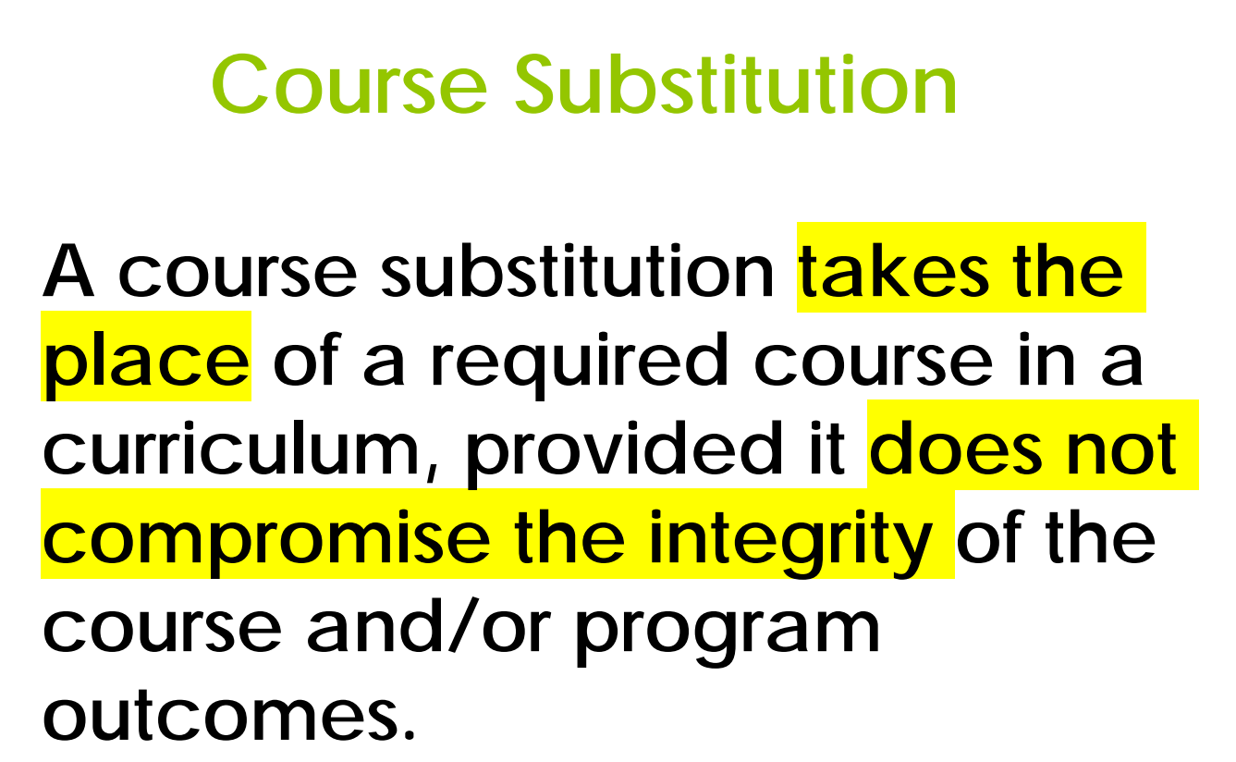

Slide 9
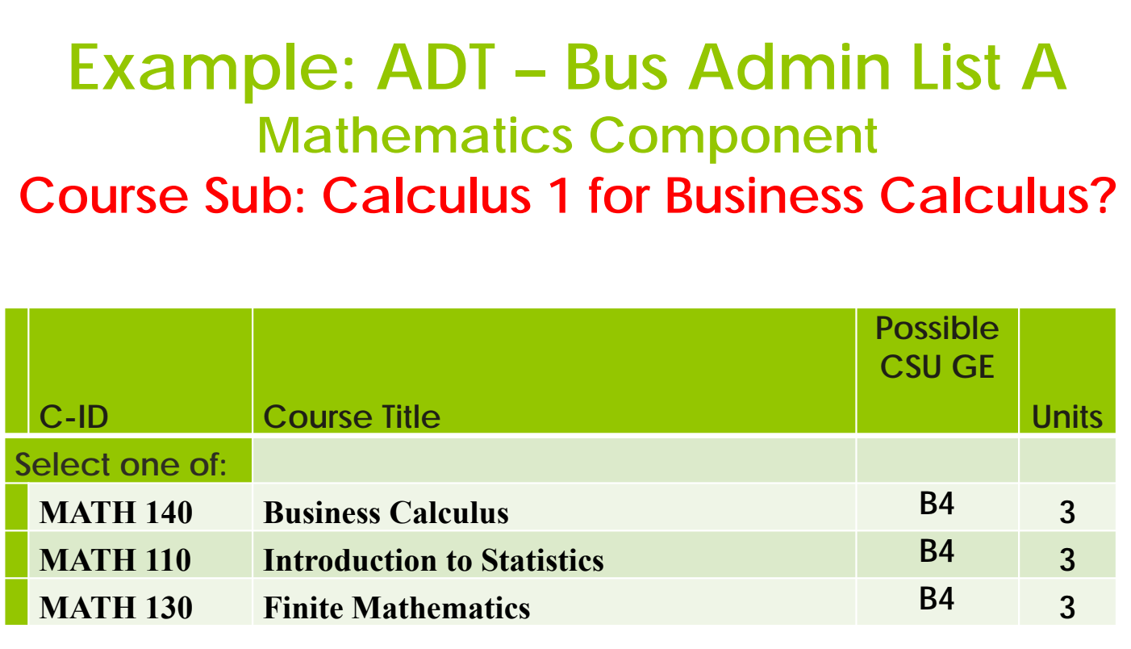

Slide 10
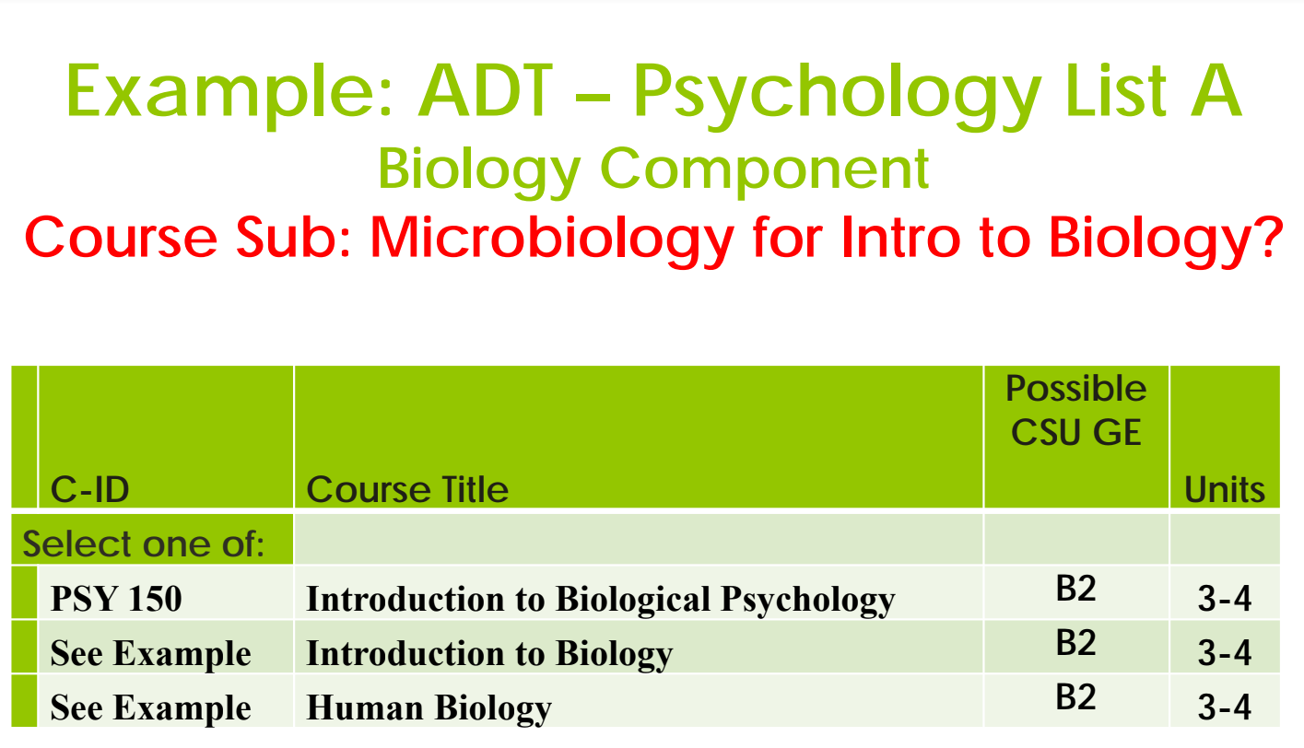

Slide 11
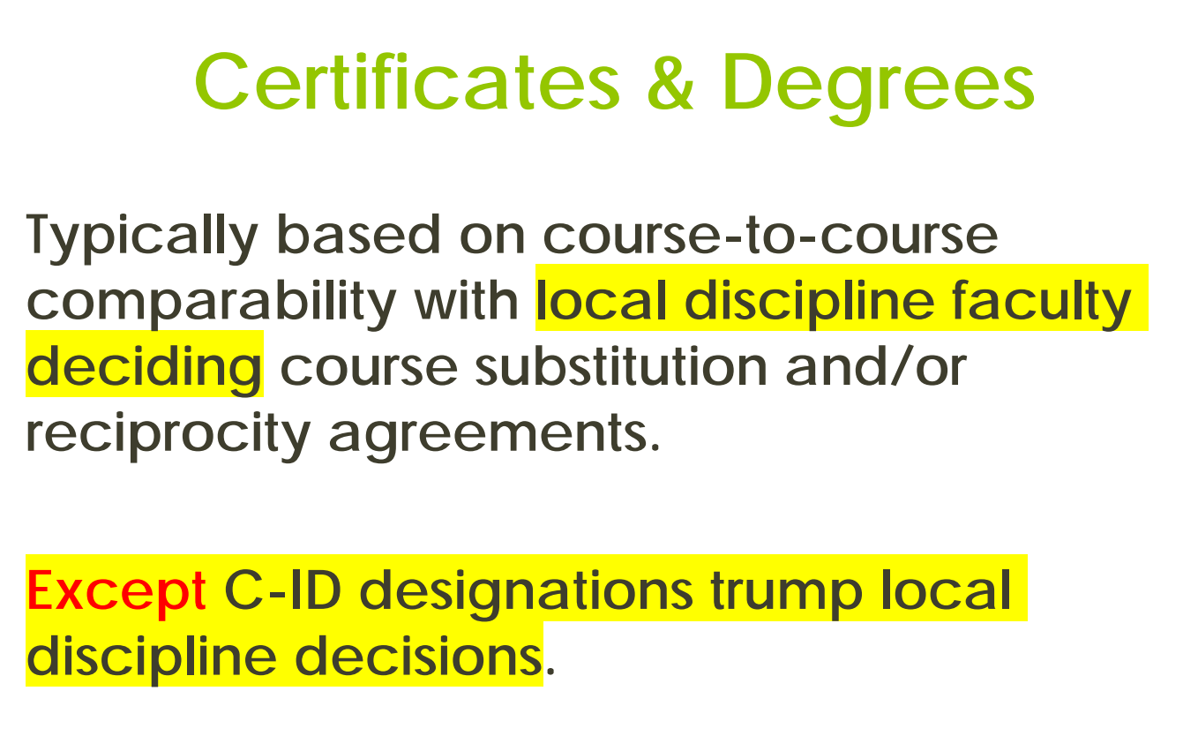

Slide 12
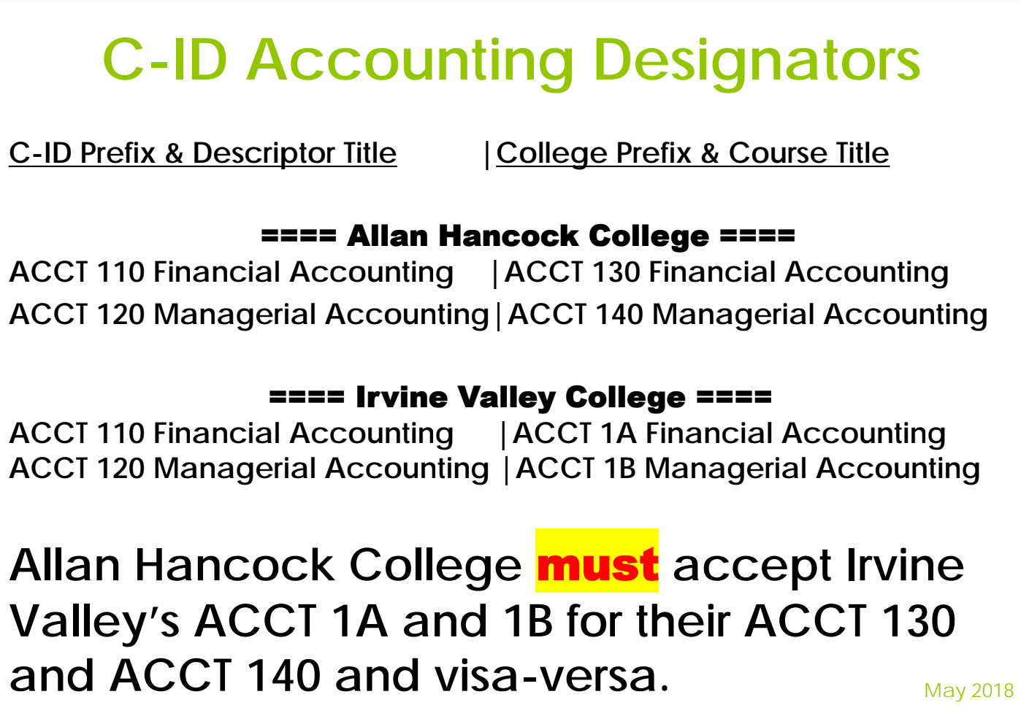

Slide 13
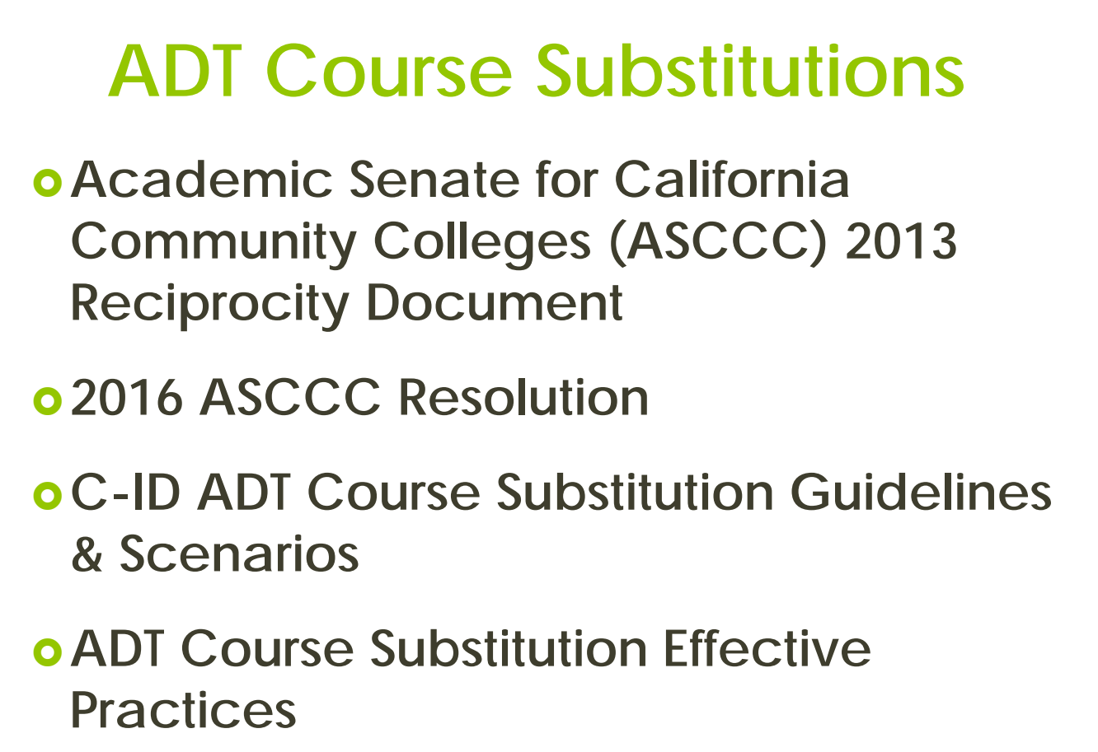

Slide 14
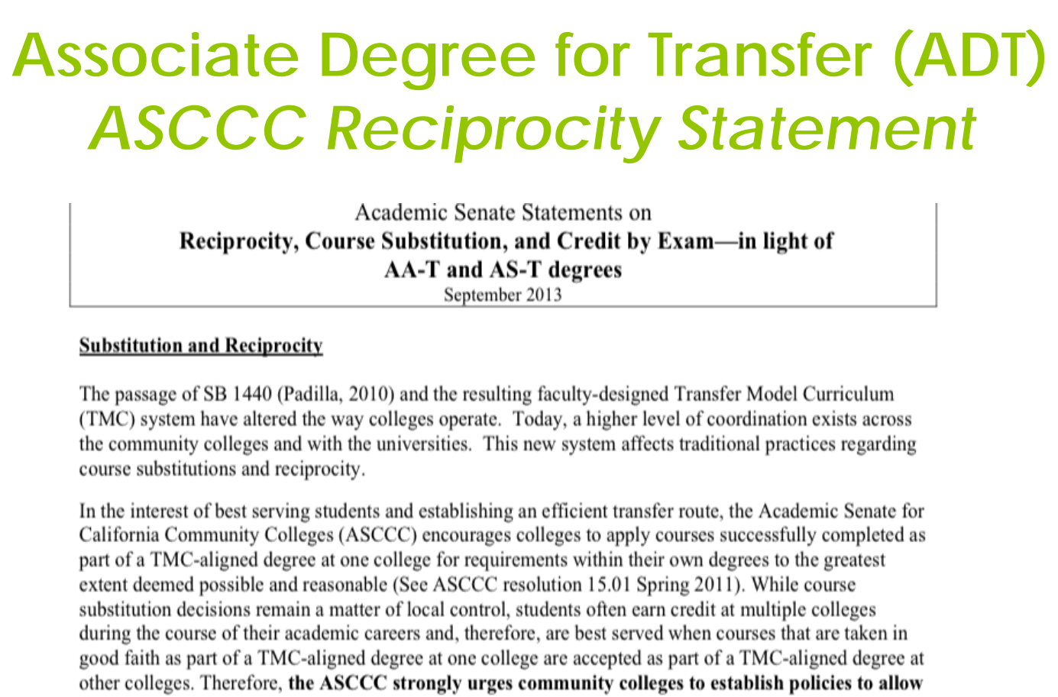

Slide 15
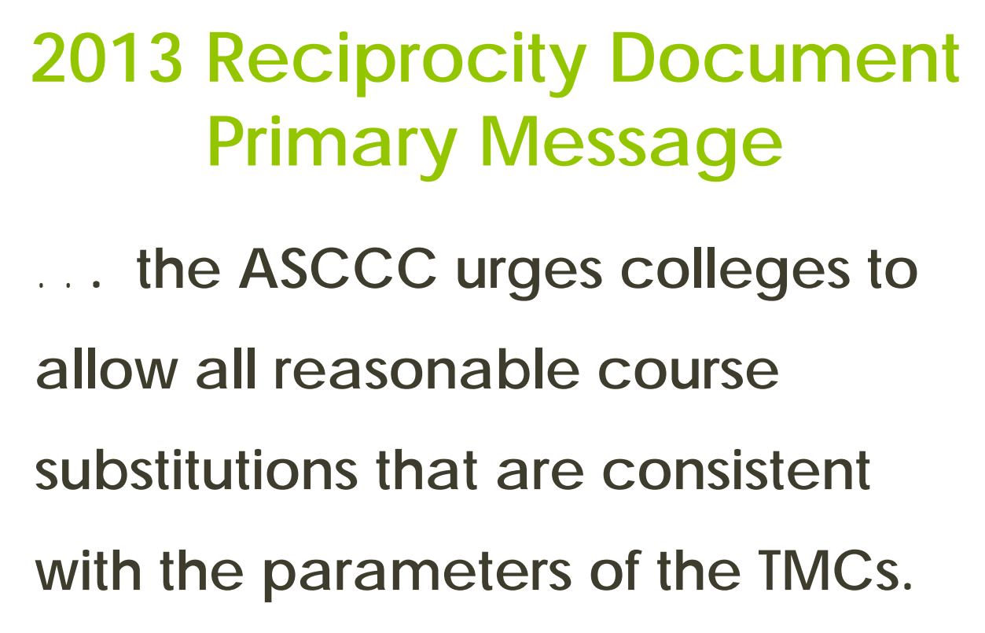

Slide 16
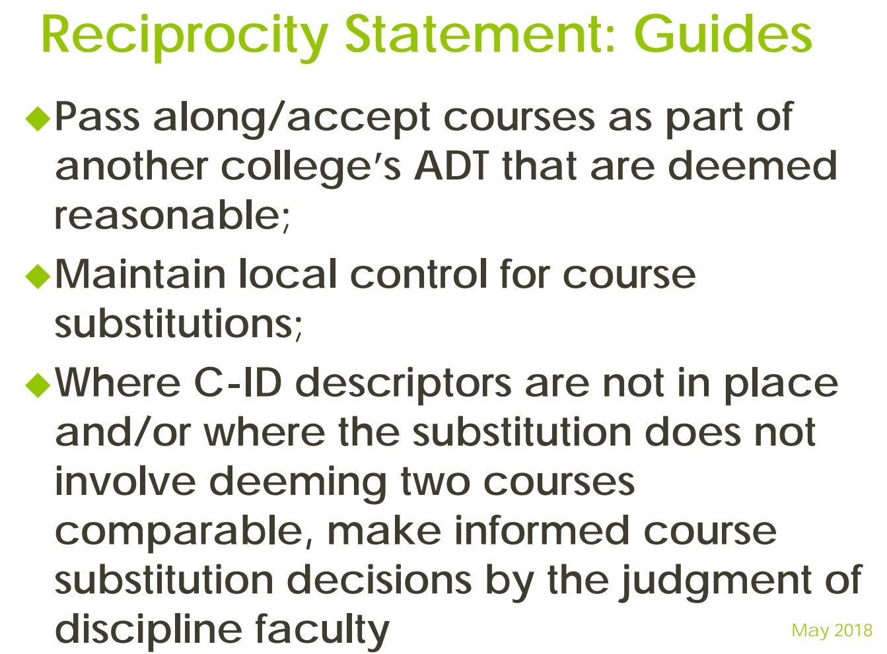

Slide 17
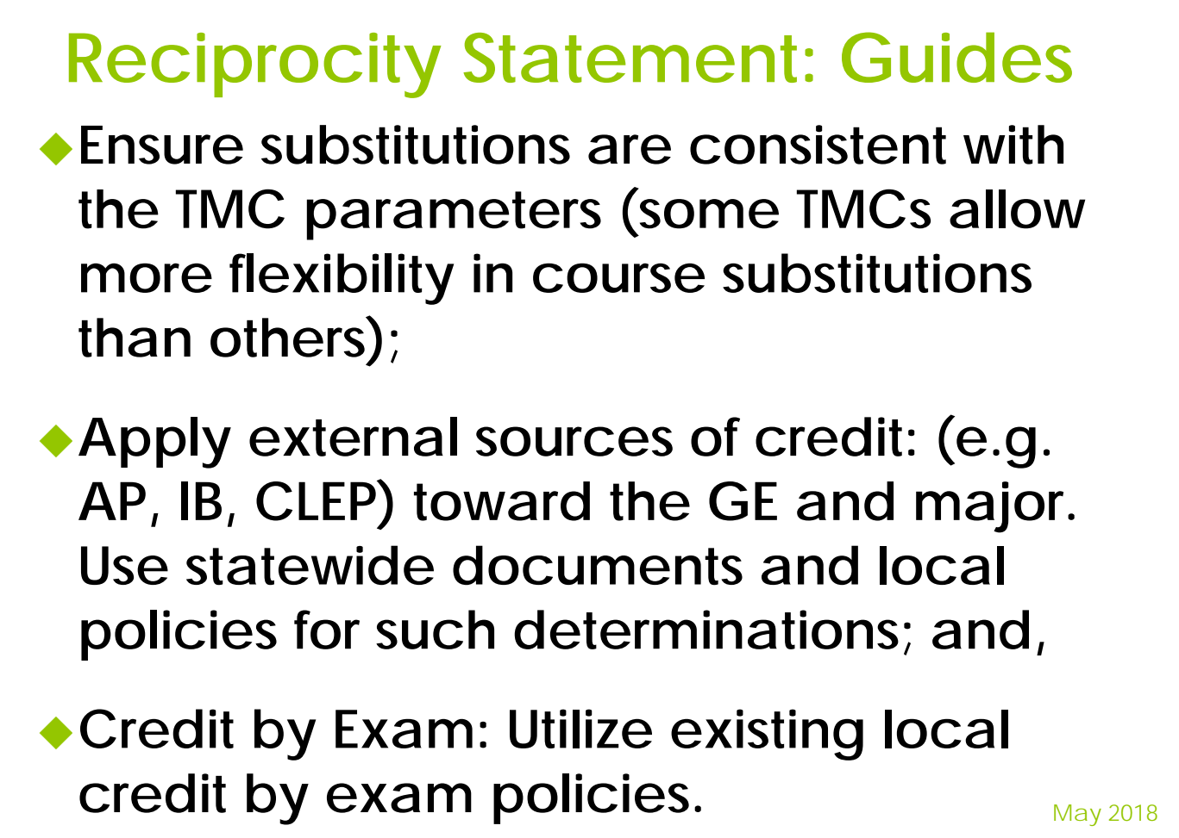

Slide 18
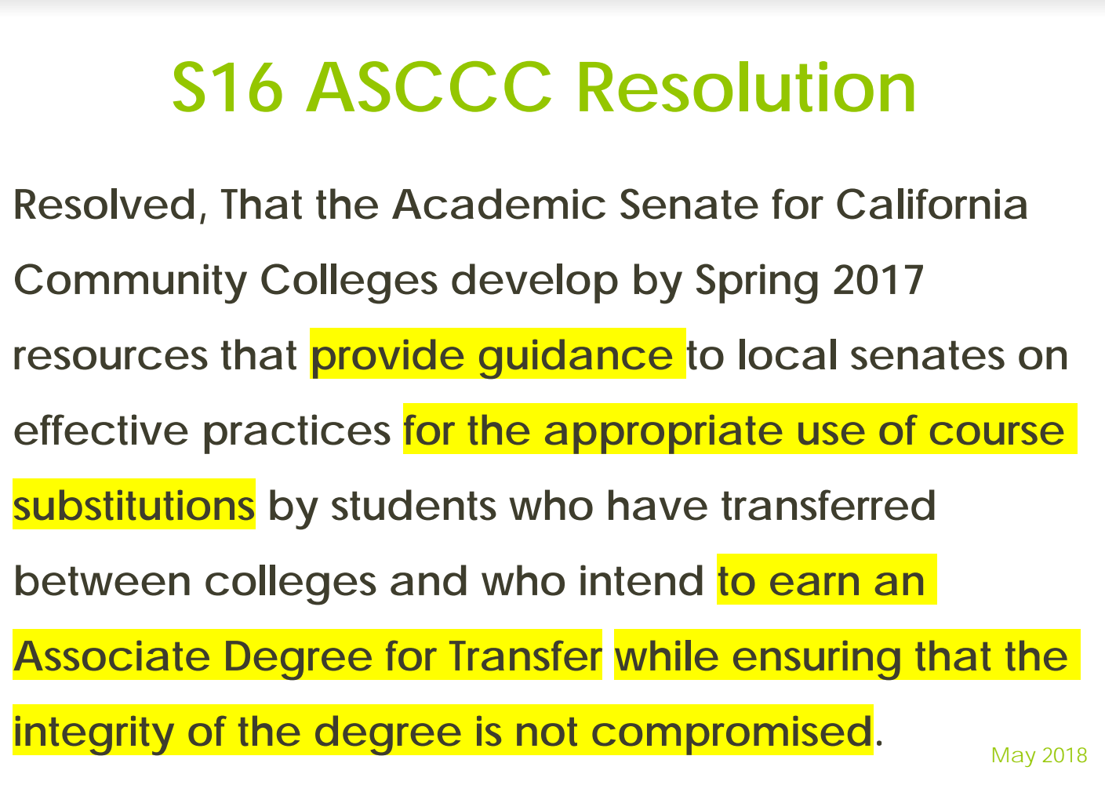

Slide 19
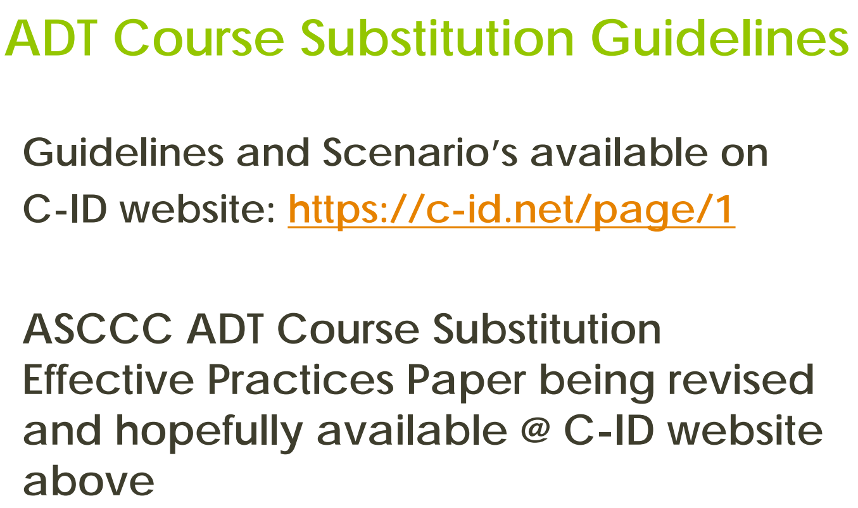

Slide 20
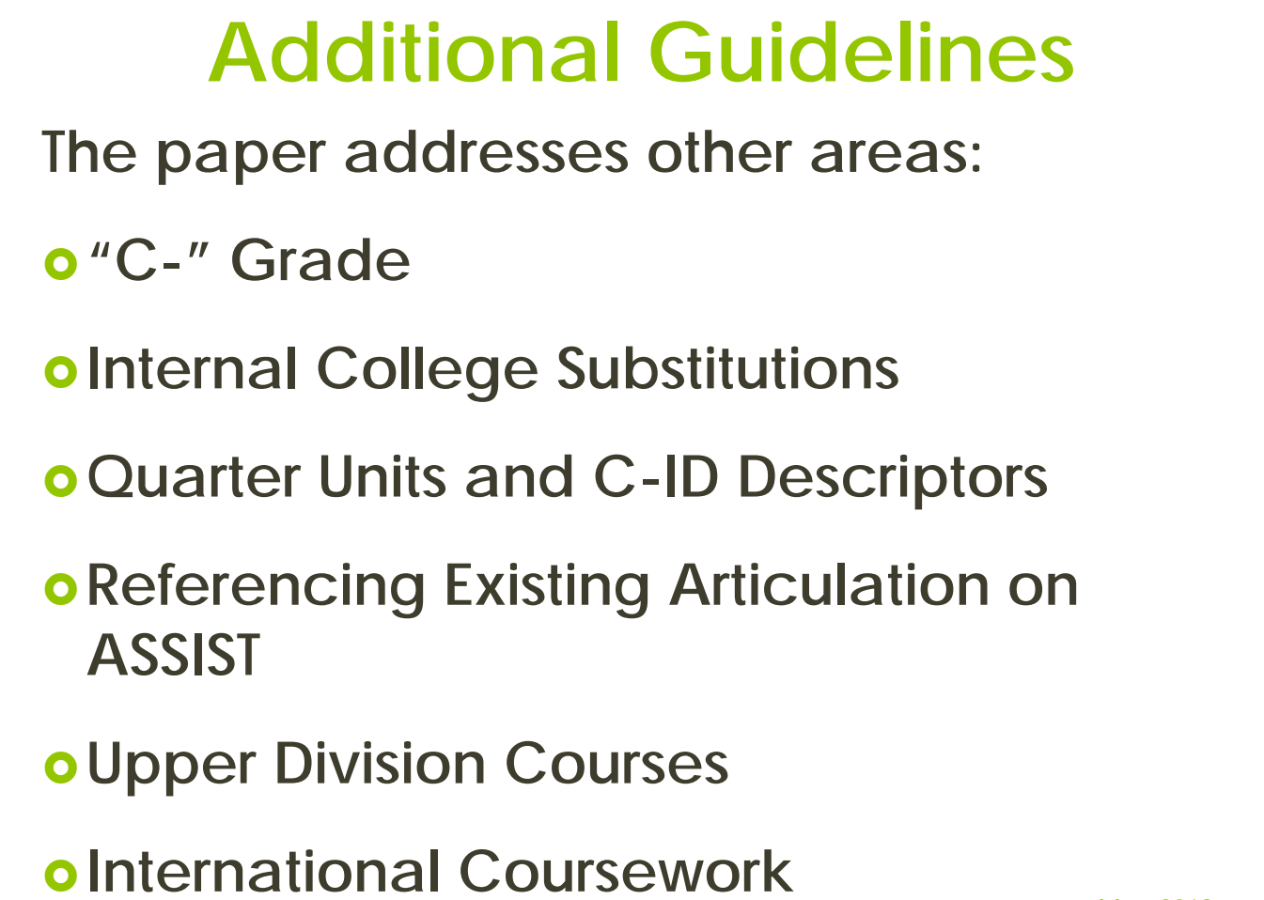

Slide 21
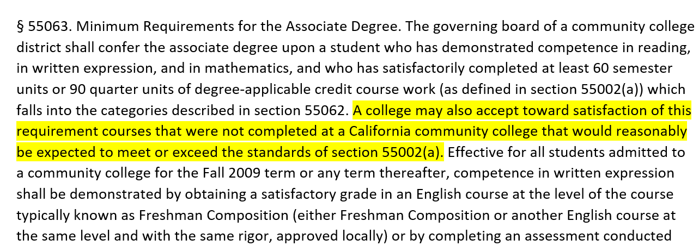
Title 5 §55063

Slide 22
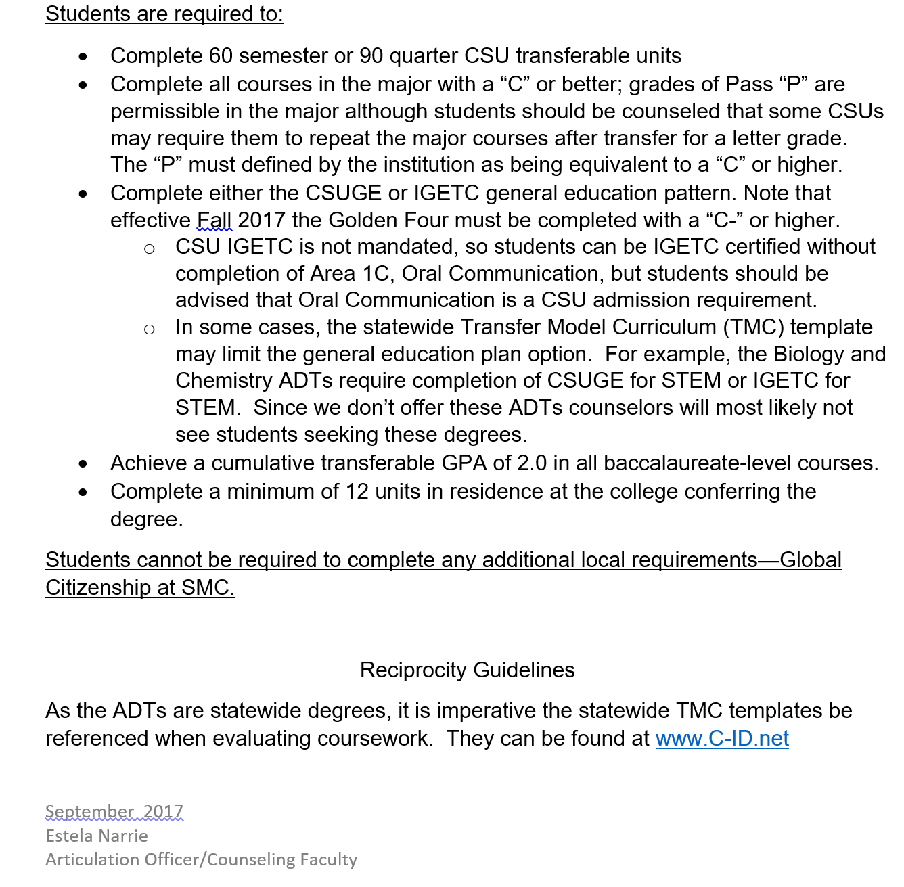
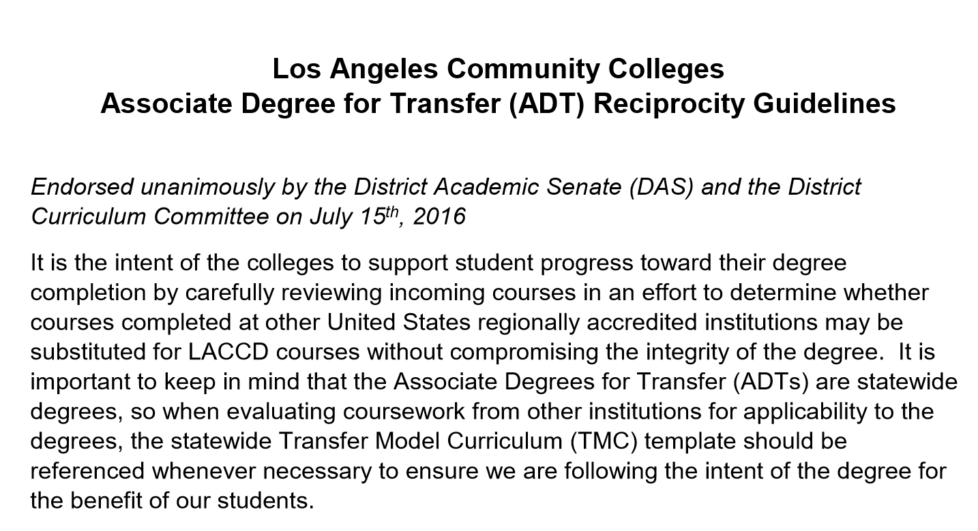
Examples from Los Angeles Community Colleges & Santa Monica College

