Slide 1
SCC Grant Process
2025
Notes:
Hello everyone. Today I am going to do a quick walkthrough from beginning to end of our Grant Process here at SCC.

Slide 2
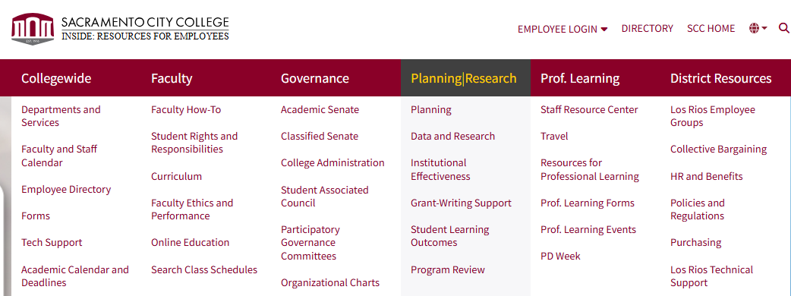
Grant Submission Process
From the employee facing webpage, select the drop down menu and go to the Grant-Writing Support page
Notes:
To start, anyone who wishes to submit a grant will want to head over to our grant-writing support page which can be found under the planning and research tab on the employee facing website.

Slide 3
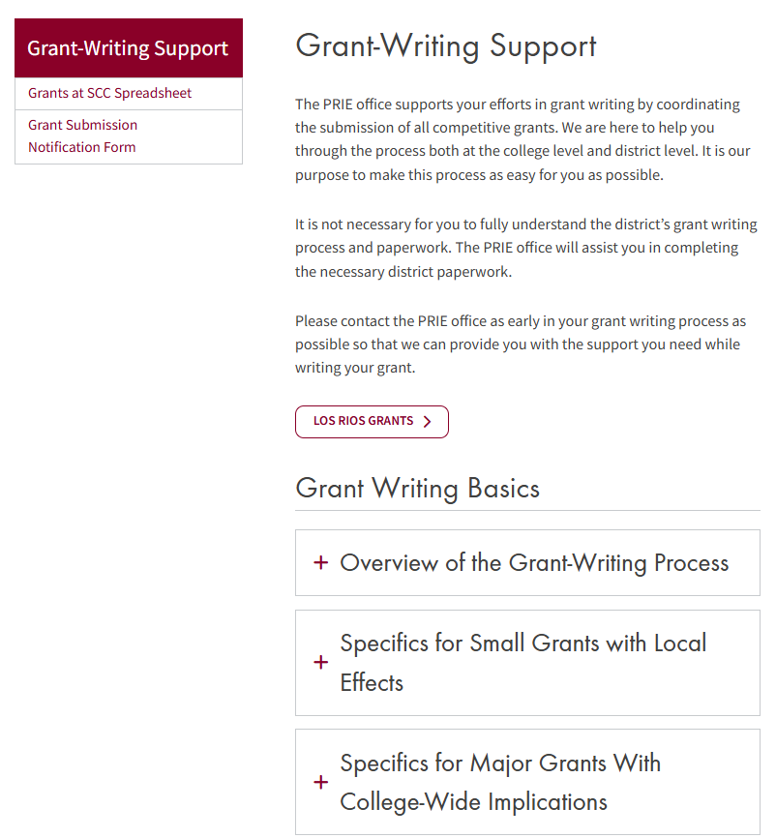
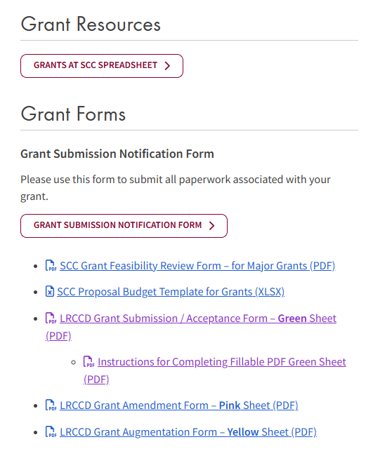
Grant Writing Support Webpage
https://inside.scc.losrios.edu/planningresearch/grant-writing-support
Notes:
On our grant-writing support page we have grant-writing basics and resources, however I won’t go too much into that right now. Instead I will focus on the submission process and include a link to the webpage so you can follow along/explore.

Slide 4
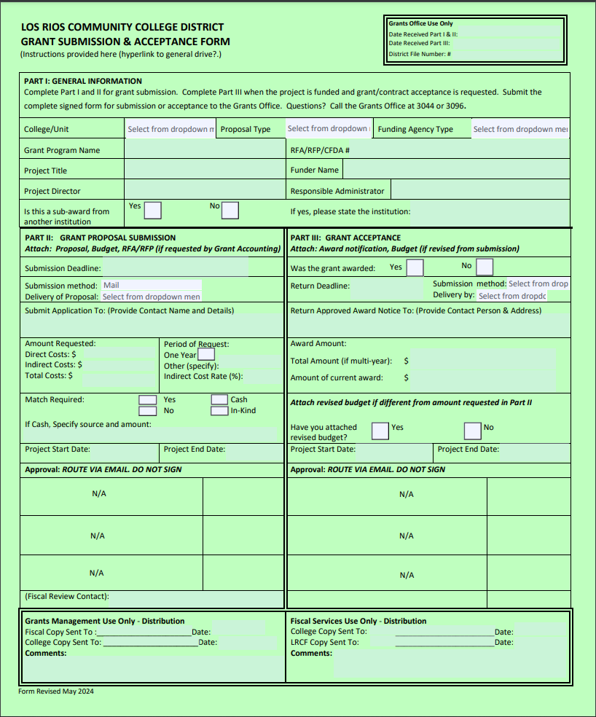
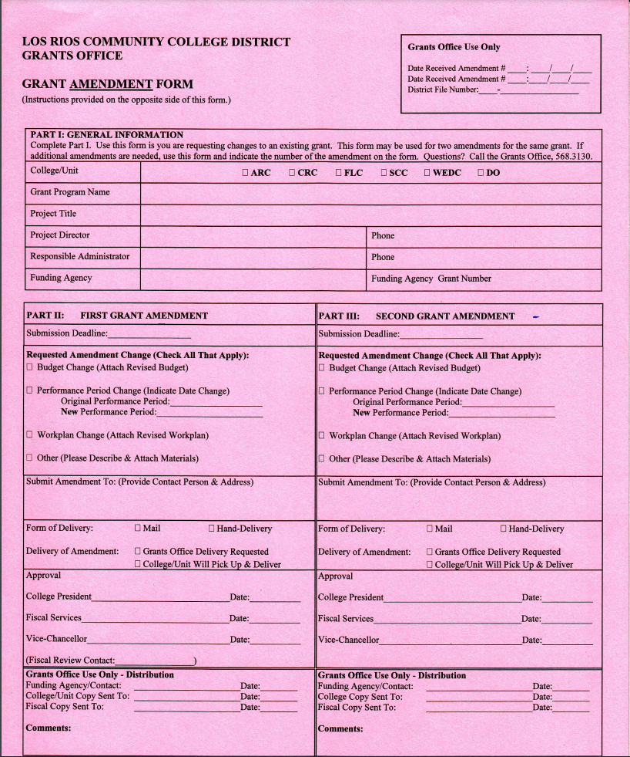
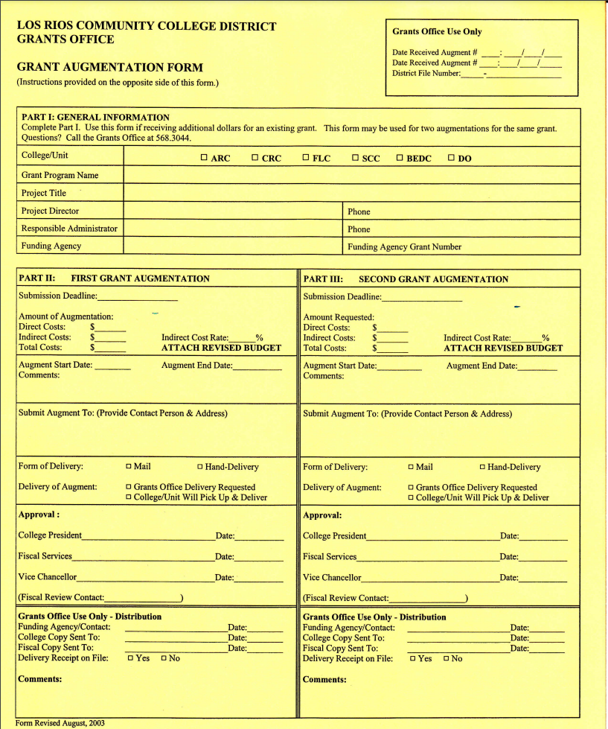
Grant Writing Support Webpage
https://inside.scc.losrios.edu/planningresearch/grant-writing-support
Notes:
At the bottom of our grant-writing support page we have links to each of the grant forms that people can download, along with instructions for how to fill out the green sheet.

Slide 5
Grant Writing Support Webpage
https://inside.scc.losrios.edu/planningresearch/grant-writing-support
Notes:
At the bottom of our grant-writing support page we have links to each of the grant forms that people can download, along with instructions for how to fill out the green sheet.

Slide 6
Grant Writing Support Webpage
https://inside.scc.losrios.edu/planningresearch/grant-writing-support
Notes:
At the bottom of our grant-writing support page we have links to each of the grant forms that people can download, along with instructions for how to fill out the green sheet.

Slide 7
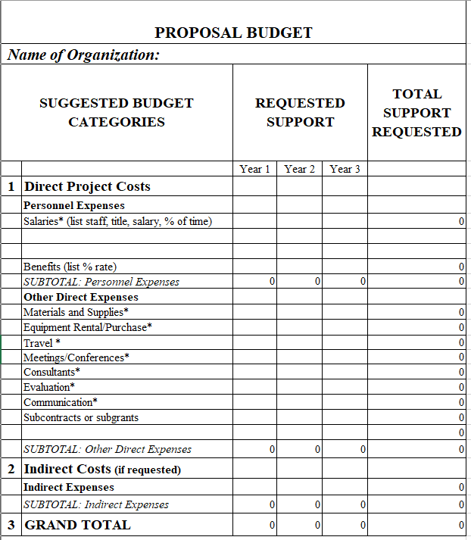
Grant Writing Support Webpage
https://inside.scc.losrios.edu/planningresearch/grant-writing-support
Notes:
At the bottom of our grant-writing support page we have links to each of the grant forms that people can download, along with instructions for how to fill out the green sheet.

Slide 8
Grant Writing Support Webpage
https://inside.scc.losrios.edu/planningresearch/grant-writing-support
Notes:
Along with a proposal budget template.

Slide 9
Grant Writing Support Webpage
https://inside.scc.losrios.edu/planningresearch/grant-writing-support
Notes:
Also underneath this heading there is a link to our grant submission notification form which can also be found in the left hand panel. This is what we are going to look at now

Slide 10
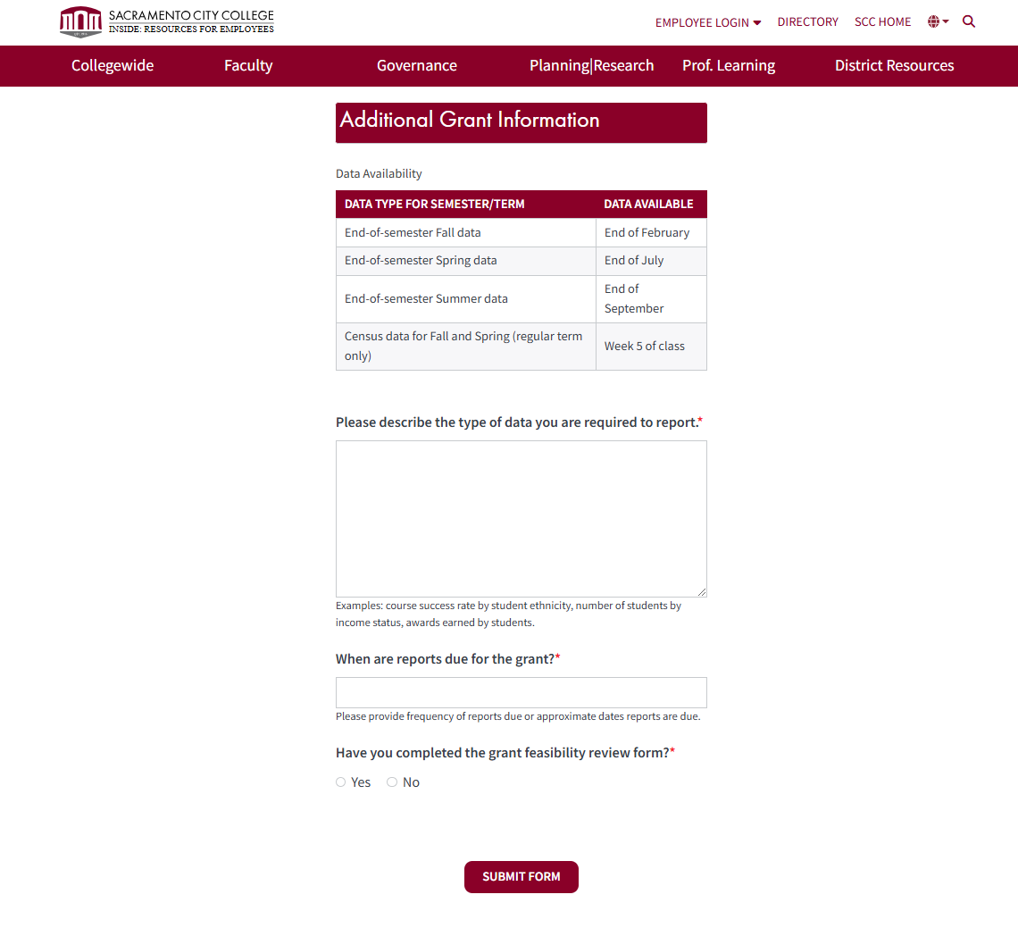
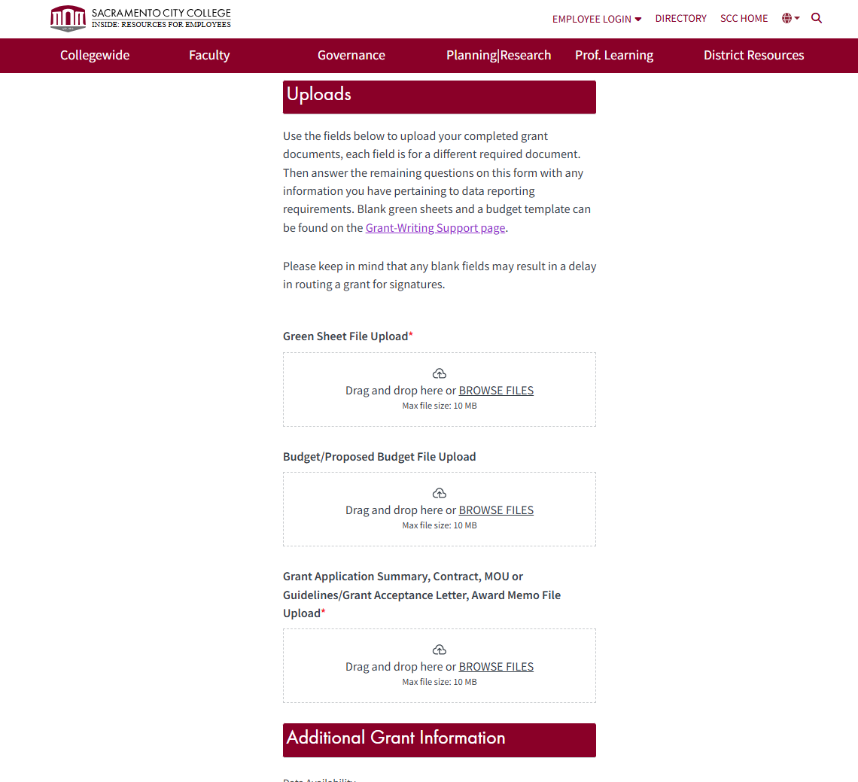
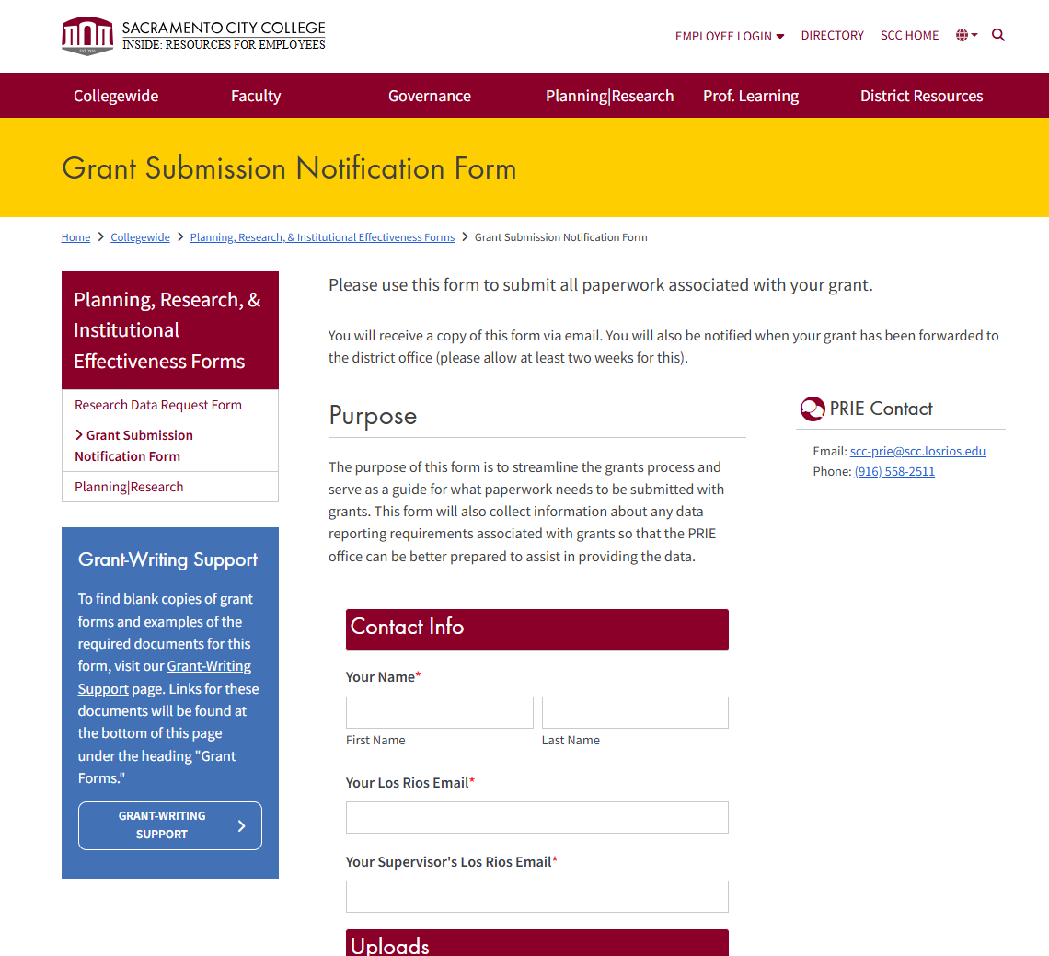
Grant Submission Notification Form
https://inside.scc.losrios.edu/collegewide/planning-research-and-institutional-effectiveness-forms/grant-submission-notification-form

Slide 11
Grant Submission Notification Form
https://inside.scc.losrios.edu/collegewide/planning-research-and-institutional-effectiveness-forms/grant-submission-notification-form
Notes:
If you click on this link, you will be taken to the grant submission form. The requestor will fill out each of the fields, highlighted in yellow on the screen.

Slide 12
Grant Submission Notification Form
https://inside.scc.losrios.edu/collegewide/planning-research-and-institutional-effectiveness-forms/grant-submission-notification-form
Notes:
This part of the form is where requestors will upload each of the required documents. First, a completed green sheet, then a budget. Both of these items are come from the Project Director or the Responsible Administrator of the grant. The final document to be uploaded is a grant application summary, contract, MOU or guidelines, a grant acceptance letter, or award memo. This document will be one that is from the agency that is funding the grant.

Slide 13
Grant Submission Notification Form
https://inside.scc.losrios.edu/collegewide/planning-research-and-institutional-effectiveness-forms/grant-submission-notification-form
Notes:
This part of the form is to prepare our office to meet any data reporting needs associated with the grant.

Slide 14
Please email: scc-prie@scc.losrios.edu with any questions
Thank you

